Slide 1
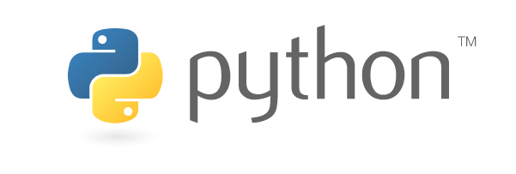
Working with Anaconda and python libraries
October 26, 2020
Mike Babb, Ph.C.
Center for Social Science Computation and Research
Department of Geography, UW

Slide 2
Installing Anaconda On Your Computer
If you need to install Anaconda
https://www.anaconda.com/distribution/
Make sure to select the Python 3.7, 64-bit, graphical installer version
Download and install, accept all defaults.
It will take 10-15 minutes

Slide 3
Working with Anaconda
Create a new environment named ‘intro_to_python’
Install jupyter notebook – interactive python
Install matplotlib – graphing and plotting
Install Descartes – plotting geographic data
Install openpyxl – reading and writing excel files
Install geopandas – working with geographic data
Notes:
environment: ~ 90 seconds
Notebook ~ 80 seconds
Matplotlib ~ 80 seconds
Descartes ~ 30 seconds
Openpyxl ~ 15 seconds
Geopandas ~ 240 seconds

Slide 4
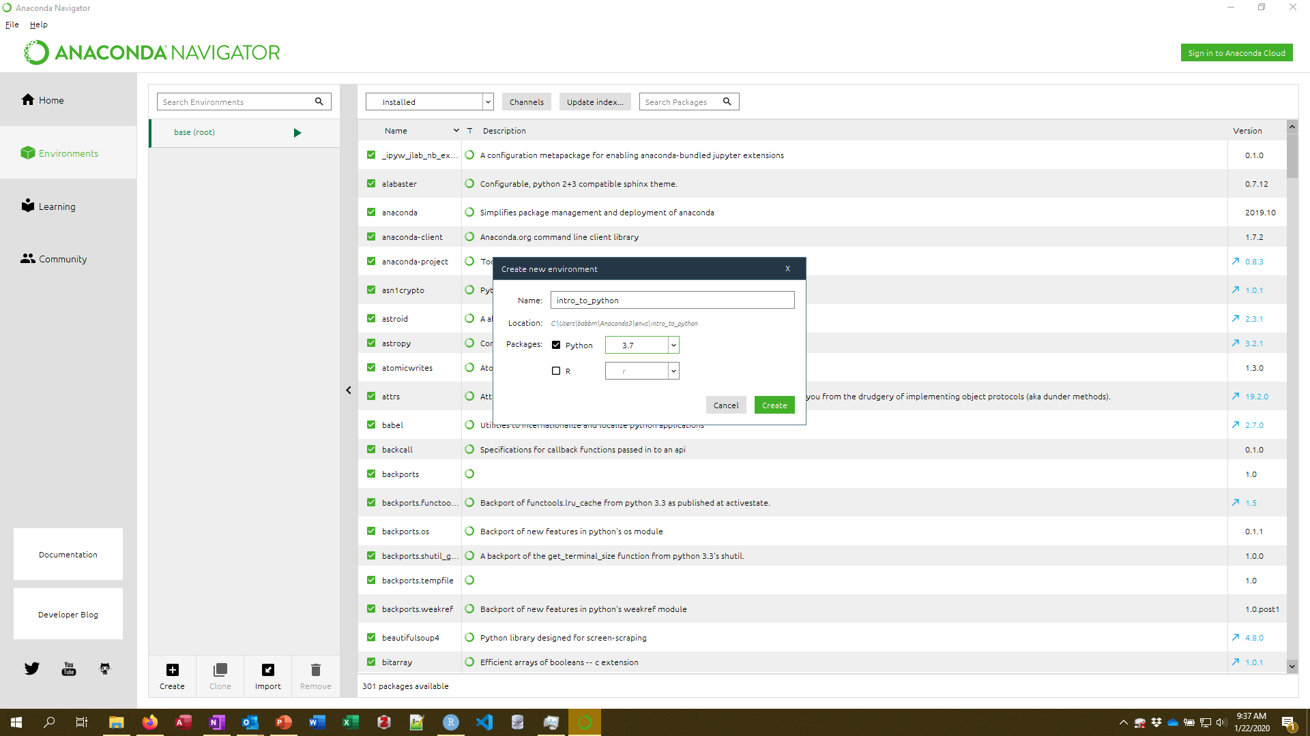
Create a new environment

Slide 5
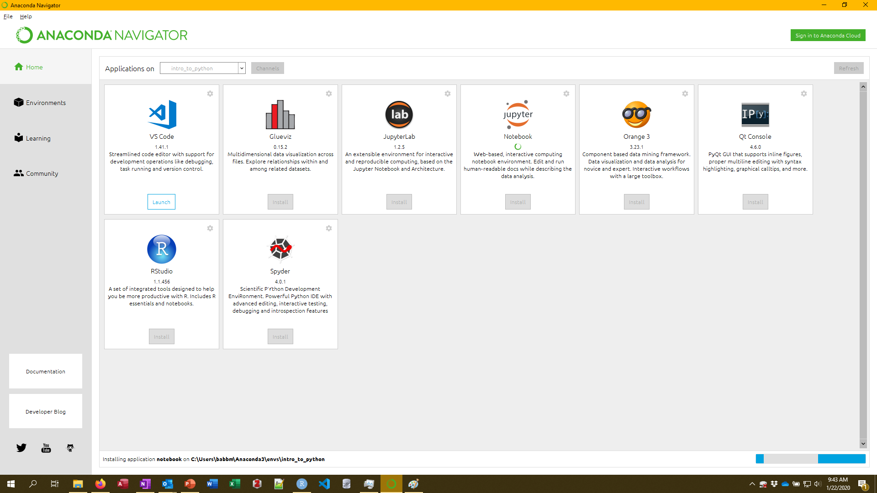
Install the jupyter notebook

Slide 6
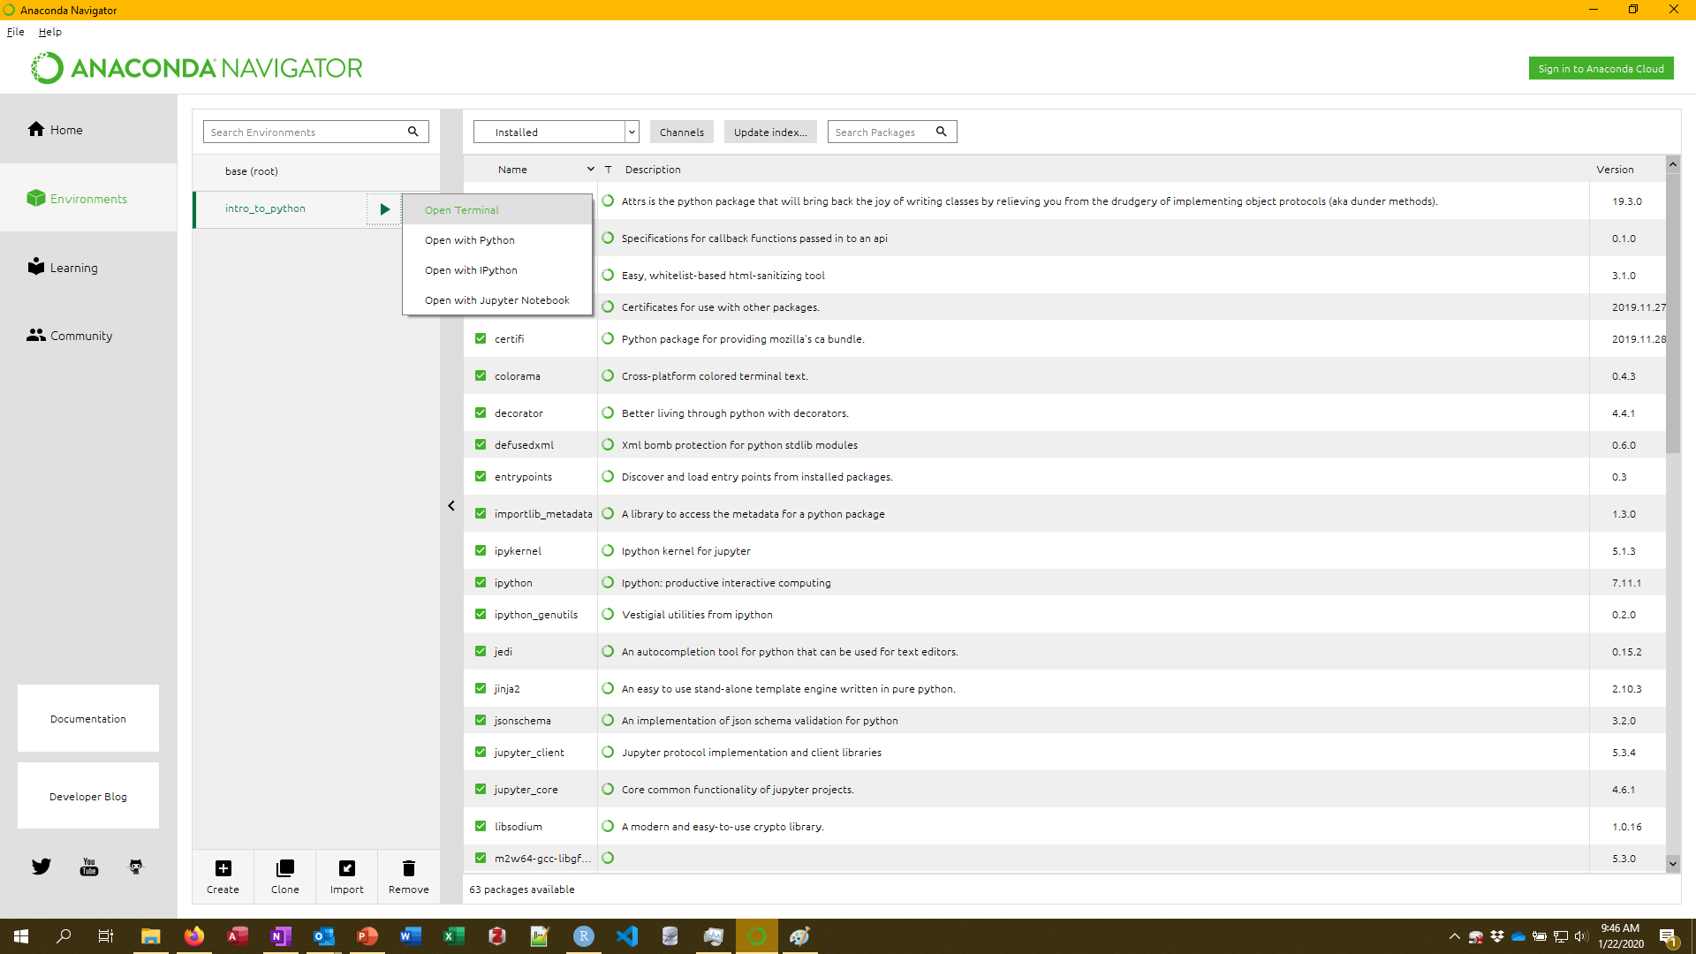
Launch the terminal

Slide 7
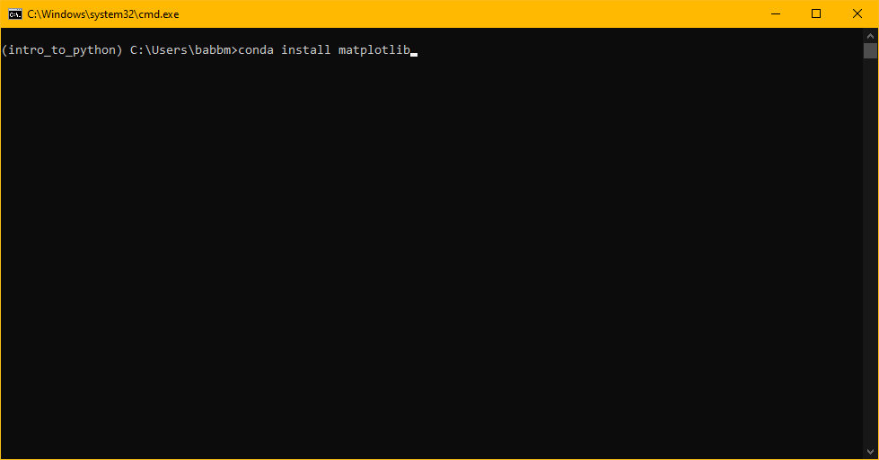
Install matplotlib
conda install matplotlib
Press y to install dependencies when prompted

Slide 8
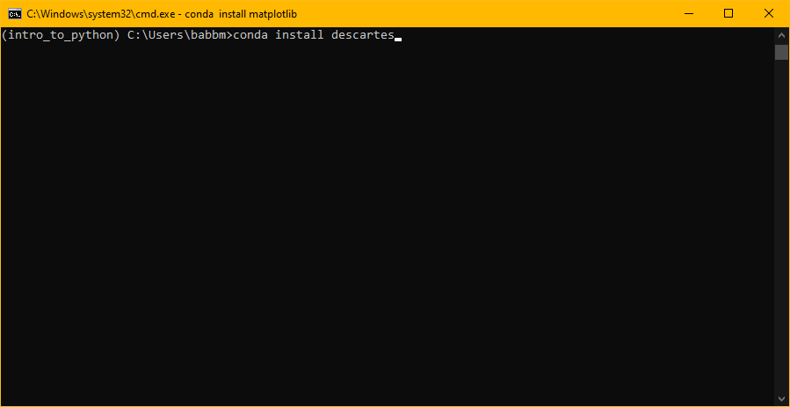
Install descartes
conda install descartes
Press y to install dependencies when prompted

Slide 9
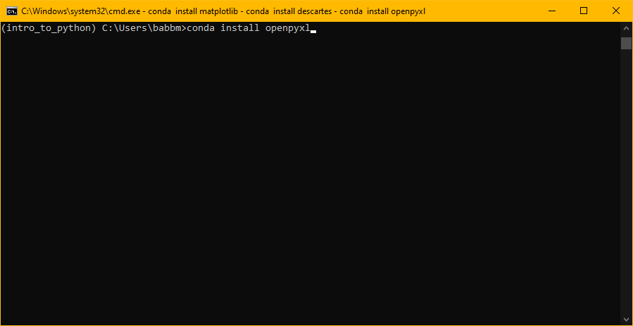
Install openpyxl
conda install openpyxl
Press y to install dependencies when prompted

Slide 10

Install geopandas
conda install geopandas
Press y to install dependencies when prompted

Slide 11
Updating Anaconda
Conda and the various python packages are easiest to update through the command line.
Warning: updating conda and each environment will take about 20 minutes.
I recommend running the update command (next page) at least once a week.

Slide 12
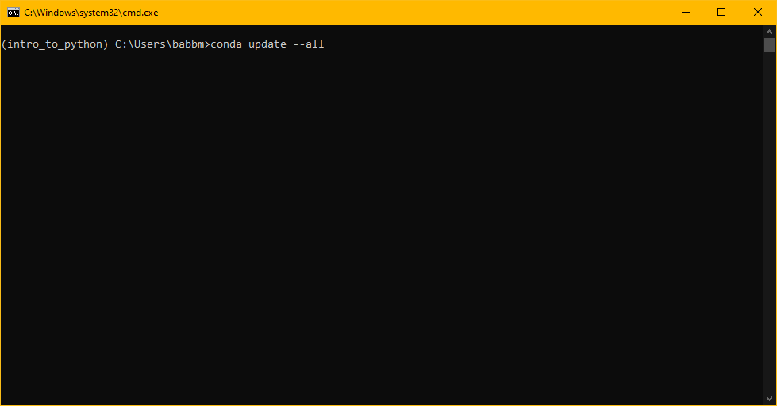
Updating packages
conda update --all
Press y to install dependencies when prompted

